Slide 1
Single Choice Point Behavioral Data
Maya Jay JUS 2016
Notes:
-1month
-running behavioral experiments

Slide 2
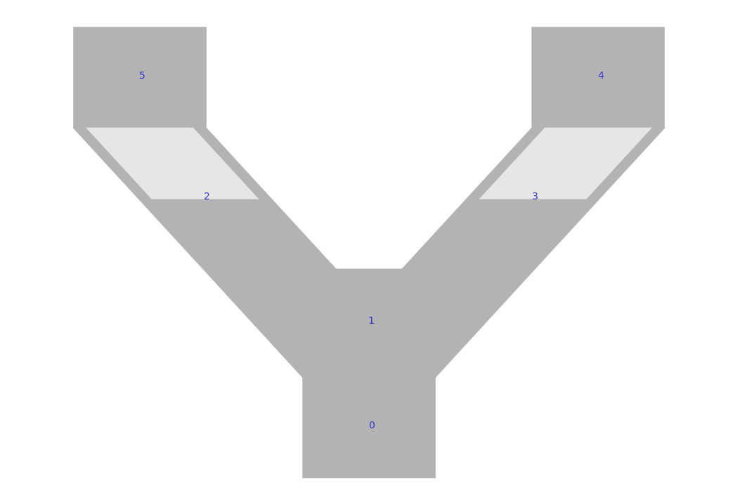
Single Choice Point Maze
Reward Zone
Reward Zone
Choice Point
Notes:
-sort of more recently, the rig has been updated to have a third wall to add to the VR, so now the mouse has both two walls on the sides as well as a front wall
-this gives us the ability to create path blocks and more complex mazes instead of the old corridors.
We have been using the front wall to construct this single- choice point maze—unbiased!
-water restricted, reward is h20

Slide 3
Navigating Away from Dead Ends
Antibias movie
Notes:
We have also used the front wall to create dead ends in our mazes, in which a mouse must learn to back up and re route itself through the maze
-no Uturns
-here’s a video of mouse navigating out of a dead end maze branch

Slide 4
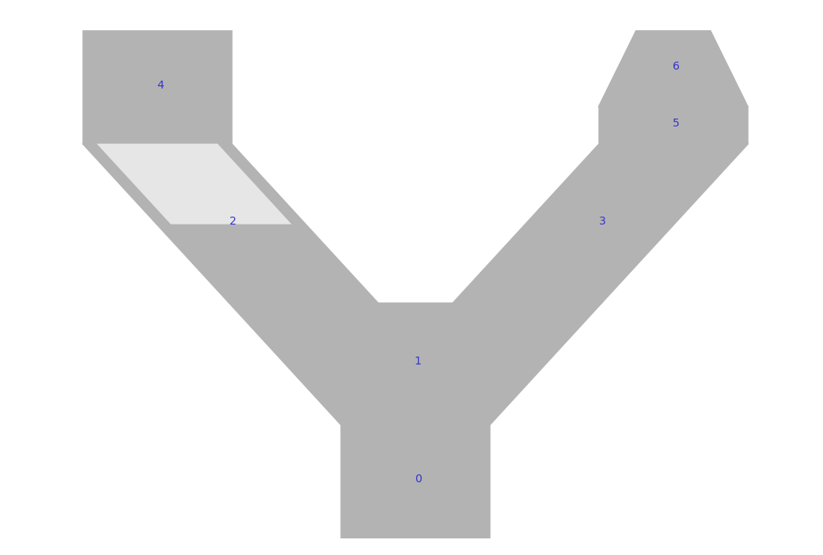
Protocol
2 days UNBIASED Y-maze
3 days ANTI-BIAS Y-maze
2 days UNBIASED Y-maze
Notes:
-use these added functionalities to investigating larger navigational abilities in mice, specifically with regards to innate biases
-some mice have innate biases, we aimed for reversal
-protocol….
-each session was 20 min, ~100-120 trials on avg

Slide 5
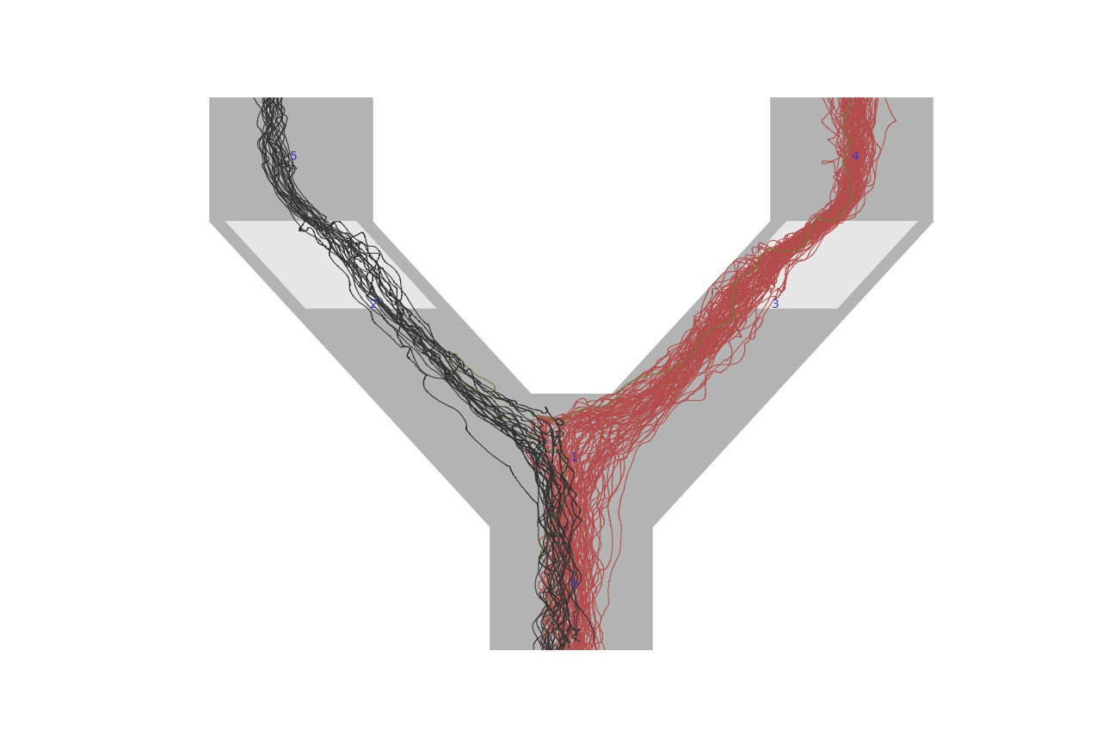
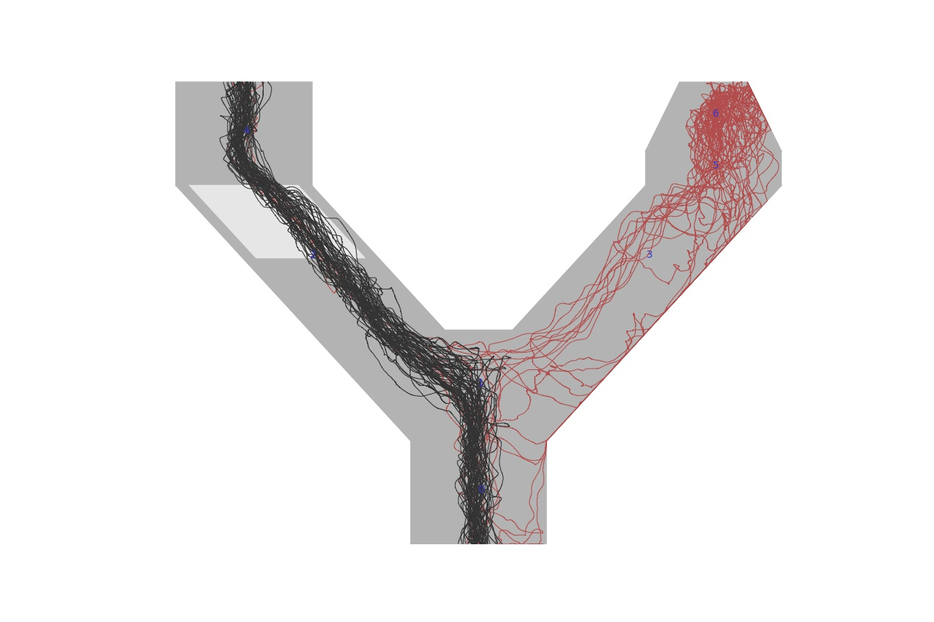
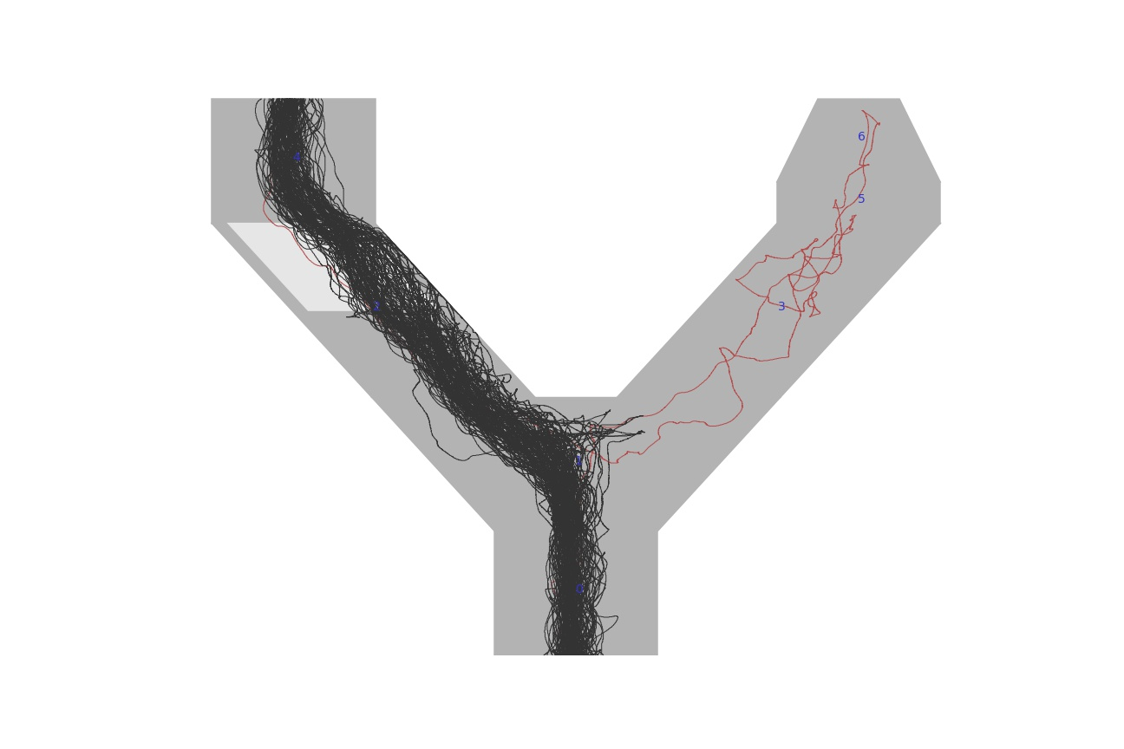
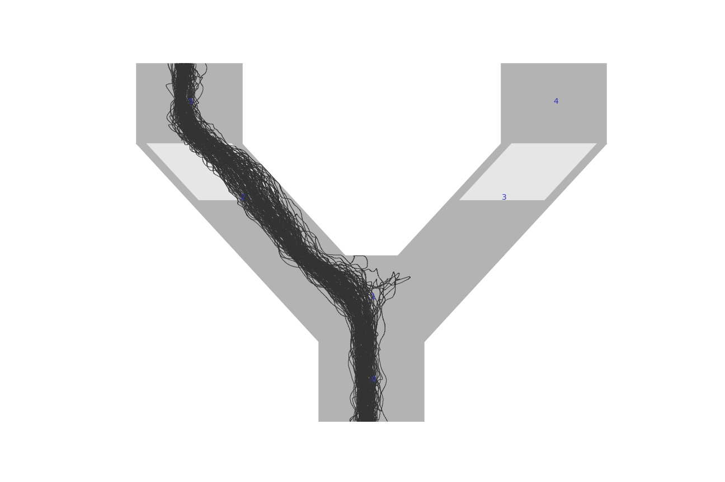
Mouse #150
Day 1 Antibias
Day 1 Unbiased
Day 2 Antibias
Day 3 Unbiased
Notes:
1 example mouse though the protocol
select days

Slide 6
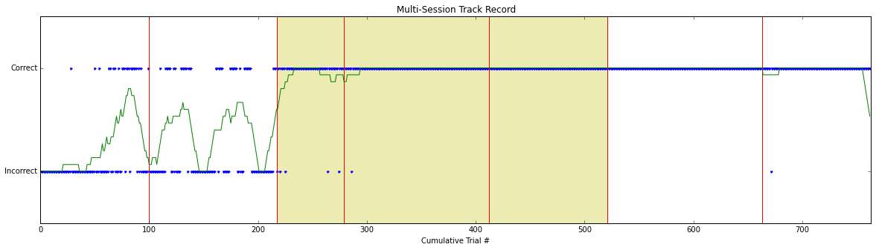
Mouse #150 Performance Summary
Notes:
-blue dots represent whether they went with their bias or against,
So Correct is ‘antibias;
Incorrect is biased
-the green line is a rolling bin average over the course of a week’s worth of sessions (7day protocol)

Slide 7
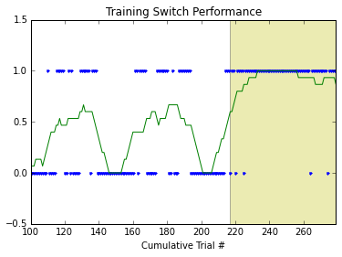
Notes:
-zoomed in on the trasiition from the second unbiased day to the first antibias day or the
Introduction of the dead end
-get a sense of learning curve

Slide 8
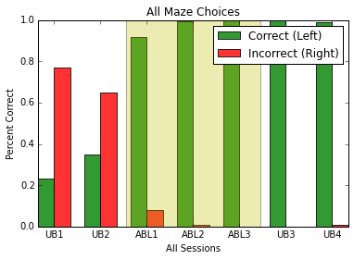
Notes:
-same mouse, an overall analysis of percent correct (antibias..in this case left)
-starts out very red, and shoots up green, and maintains green even when return to unbiased where no dead end exists

Slide 9
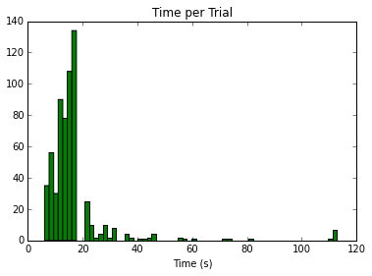
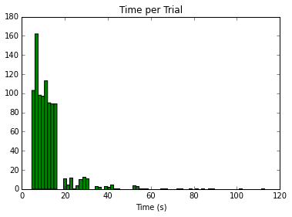
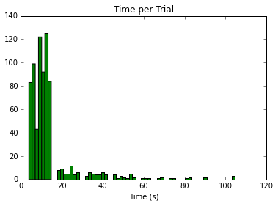
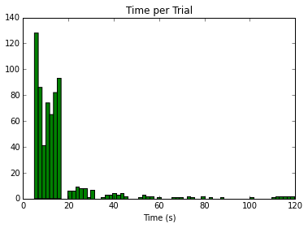
Animal 1
Animal 2
Animal 3
Animal 4
Notes:
Ran 4 animals through this protocol
Some stats here: avg time ~ 10-15s
-spikes further out may represent trials where there were time outs either due to getting stuck in a dead end or even just timing out having drank enough water or being tired of running

Slide 10
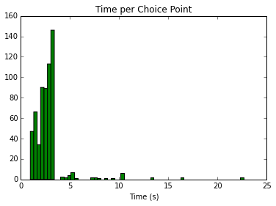
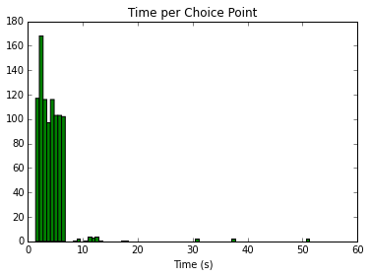
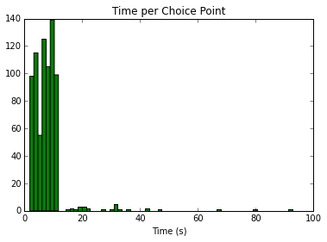
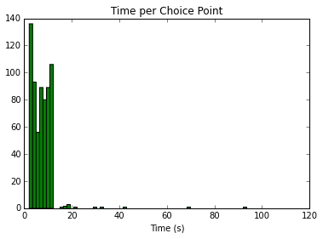
Animal 1
Animal 2
Animal 3
Animal 4
Notes:
Also able to quantify time spent in the choice point before an initial branch is chosen
~5s

Slide 11
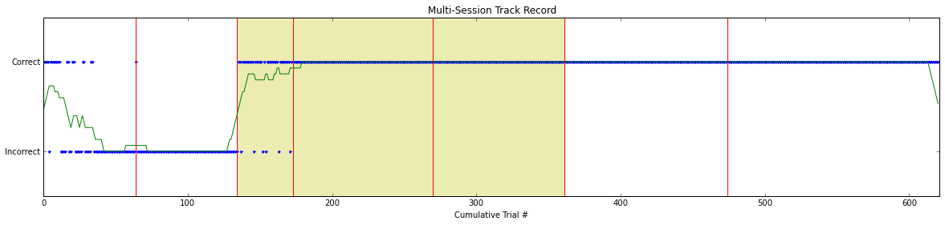
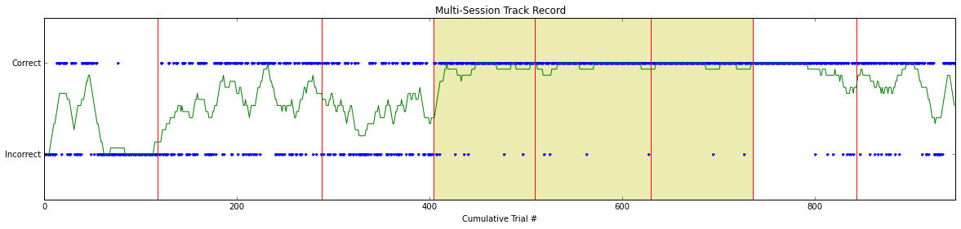
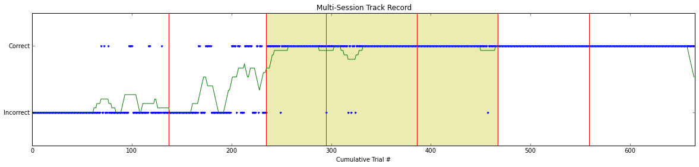
Animal 1
Animal 2
Animal 3
Animal 4
Notes:
-Animal 3 I’ve shown you before, this is a same plot representing the initial choices of all the animals over the week long protocol
The three yellow panels are the unbiased days with a deadend involved
Again the green line is rolling average

Slide 12
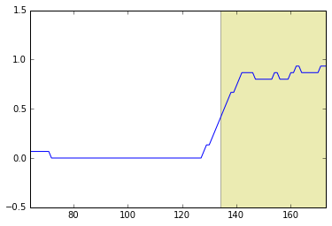
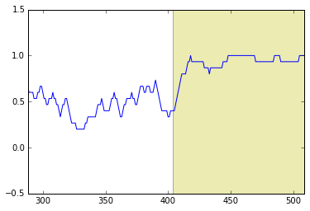
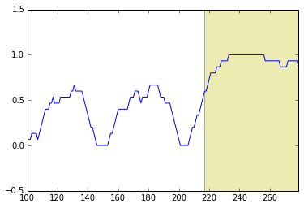
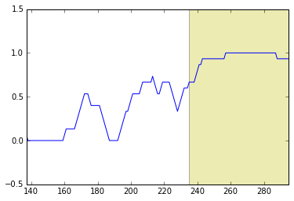
Animal 1
Animal 2
Animal 3
Animal 4
Notes:
-further zoom in values
On the transition to a dead end

Slide 13
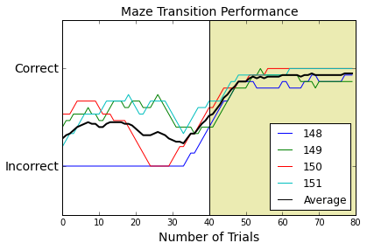
Notes:
-overlayed all the transition averages,a nd took and average of all these line to create a literal learning curve
-is this the best metric??

Slide 14
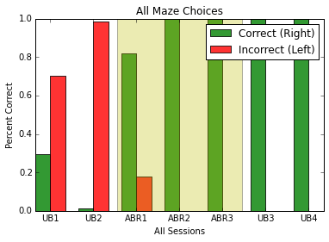
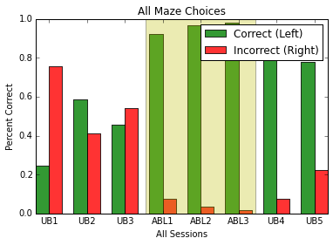
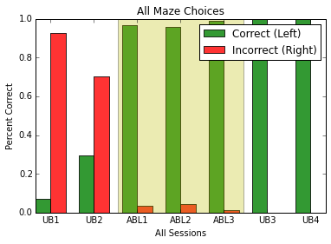
Animal 1
Animal 2
Animal 3
Animal 4

Slide 15
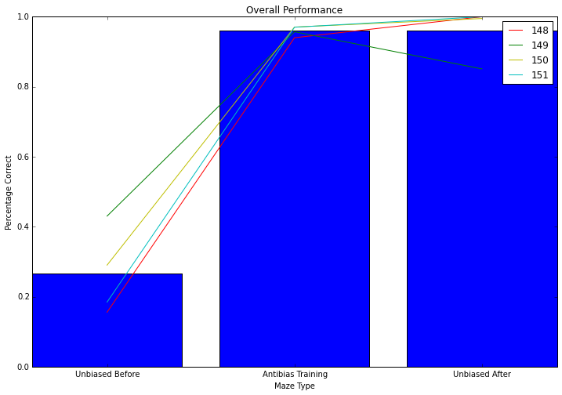

Slide 16
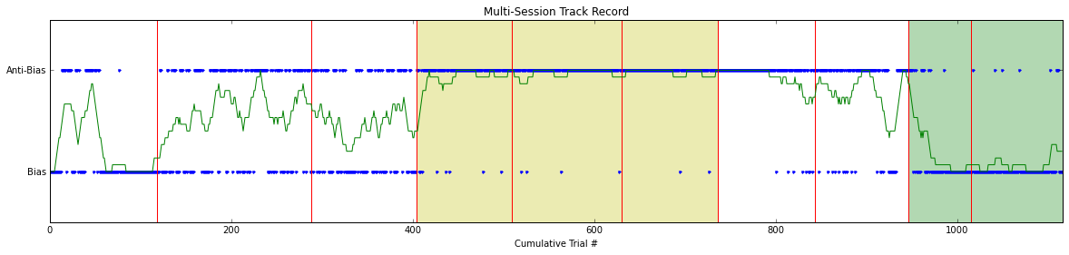
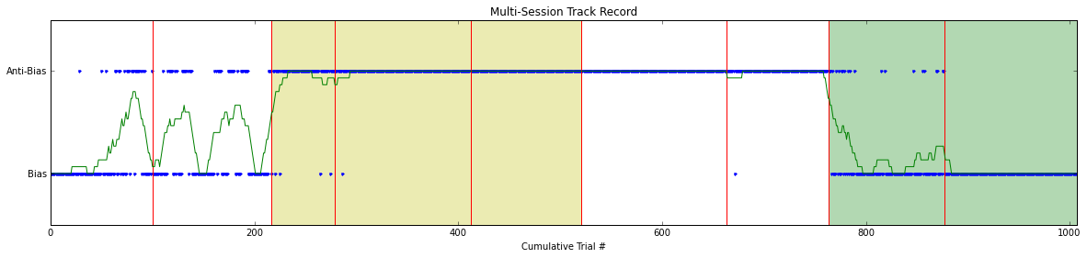
Switch Back to Pro-Bias
Animal 2
Animal 3
Notes:
The next thing we tried with the same batch of animals was to revert them against 3 days of training and 2 days of unbiased runs back in the direction of their original bias
-v successful with two of our animals!
1 animal was a fairly slow runner and often got stuck in dead ends…ie 10 time outs in 20 min
The other animal began ignoring dead ends-moving the ball forward even though the wall was in his face

Slide 17
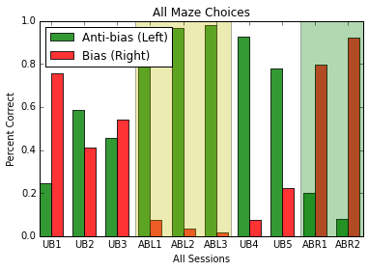
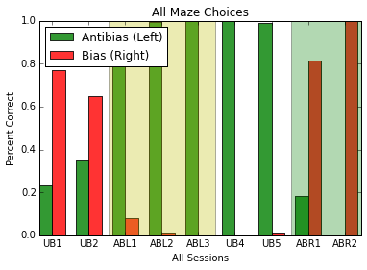
Animal 2
Animal 3
Notes:
Again another visualization where green rises and falls with the introduction and reversal of the dead end

Slide 18
Intra-Session Switching
Switching movie
Notes:
Every 20 trials
-chose 20 because of that rolling average graph
-relatively successful?

Slide 19
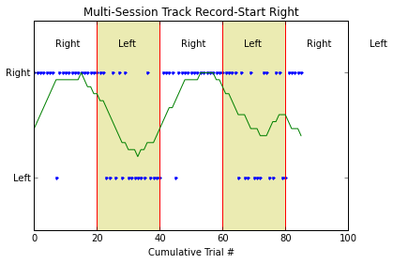
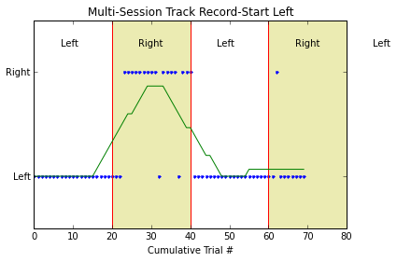
Animal 2
Animal 3

Slide 20
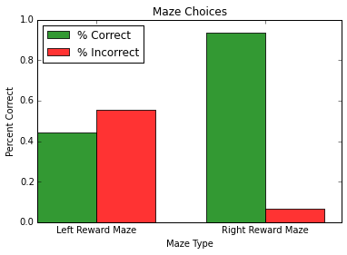
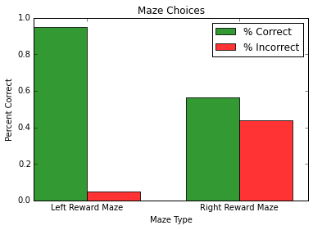
Animal 2
Animal 3
Notes:
Fighting an overtrain bias

Slide 22
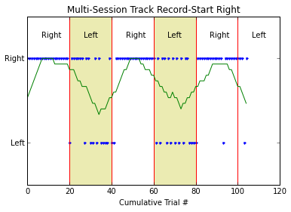
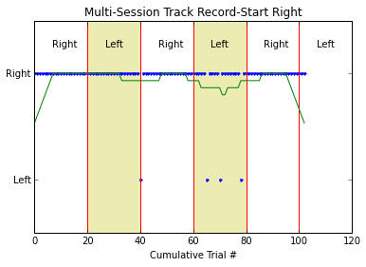
Animal 2

Slide 23
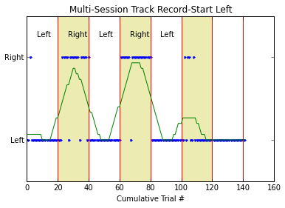
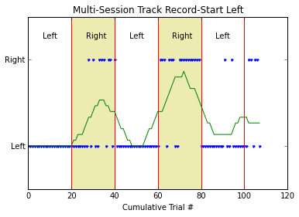
Animal 3

